Slide 1
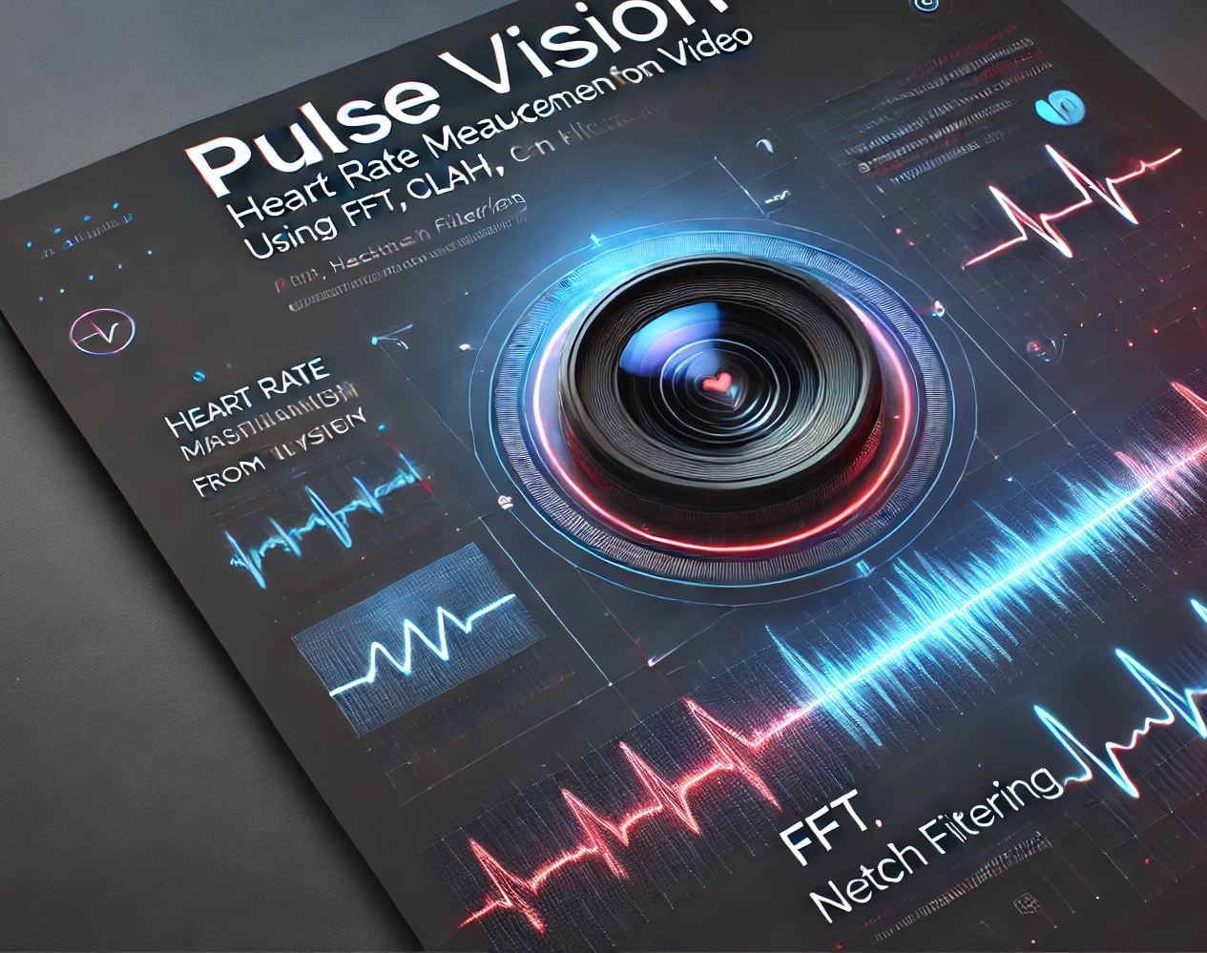
PulseVision
Video Based Heart Rate Measurement Using Variable Lighting
Presented By: Nadav Reubens
Ron Sisso
Supervised by:
Dr. Dan Lemberg
Mrs. Elena Kramer

Slide 2
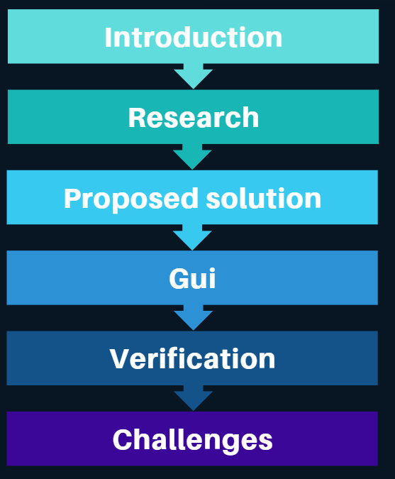
Table of content

Slide 3
introduction
needs
ways of measures
existing problem
our solution
desired outcome

Slide 4
Research
Reading and Understanding previous Project
Reading papers regarding vital sign extraction
Understanding relevant medical background
Researching suggested methods
Gathering information about tools to implement the solution

Slide 5
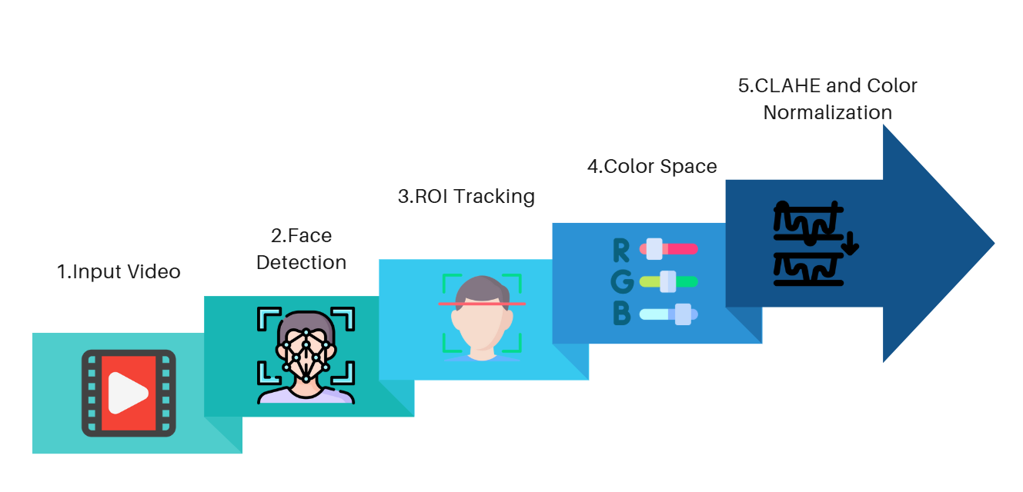
Solution pipeline

Slide 6
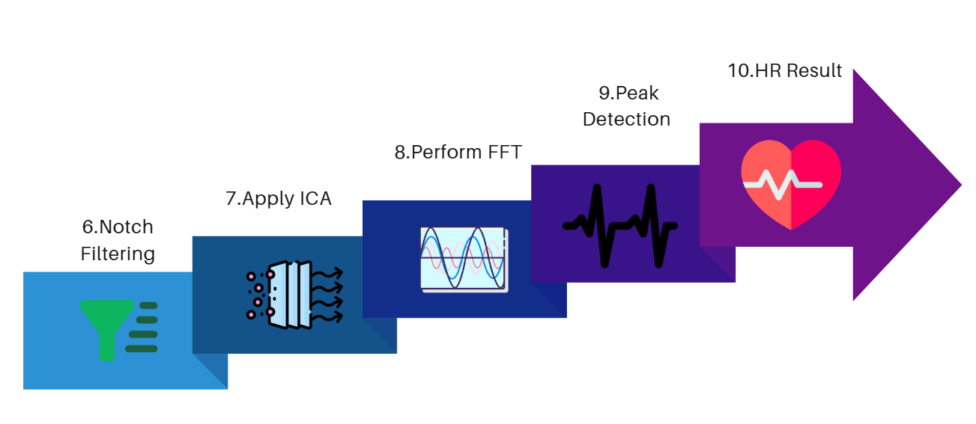
Solution pipeline

Slide 7
CLAHE & Color Normalization
Enhances Pulse Visibility: CLAHE improves local contrast, making subtle skin color changes due to blood flow more detectable.
Reduces Noise Over-Amplification: Limits contrast enhancement to prevent flickering light from distorting the signal.
Stabilizes Skin Tone Variations: Color normalization adjusts for fluctuating lighting conditions, ensuring consistent pulse extraction.
Optimizes Signal Processing: Converts RGB to YCrCb/LAB and focuses on the green channel for reliable heart rate detection.

Slide 8
Notch Filtering
Removes Flickering Light Noise: Eliminates 50/60Hz interference caused by artificial lighting.
Preserves Heart Rate Signal: Filters out only specific noise frequencies without affecting pulse information.
Enhances Accuracy: Prevents false peaks in the frequency domain, improving heart rate estimation.
Works in Real-Time: Efficient filtering method ensures smooth and continuous heart rate tracking.

Slide 9
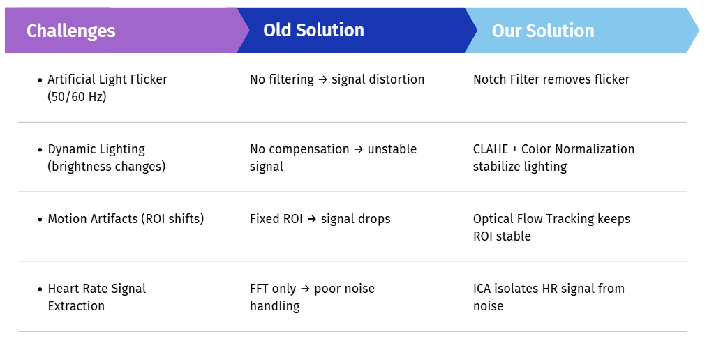
Solution Comparison

Slide 10
Precision Goals
Enhancing Heart Rate Accuracy
Minimize Mean Absolute Error (MAE) to less than 2-5 BPM.
Reduce noise interference from ambient lighting and motion artifacts.
Ensure stable and accurate readings under varying skin tones and conditions.
Optimize processing for real-time heart rate detection.
Validate results across diverse test subjects and conditions.

Slide 11

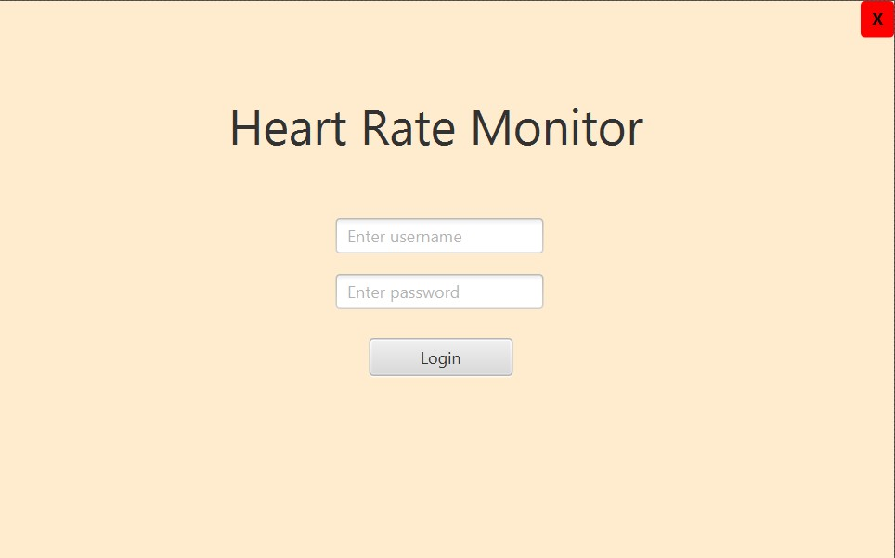
GUI

Slide 12

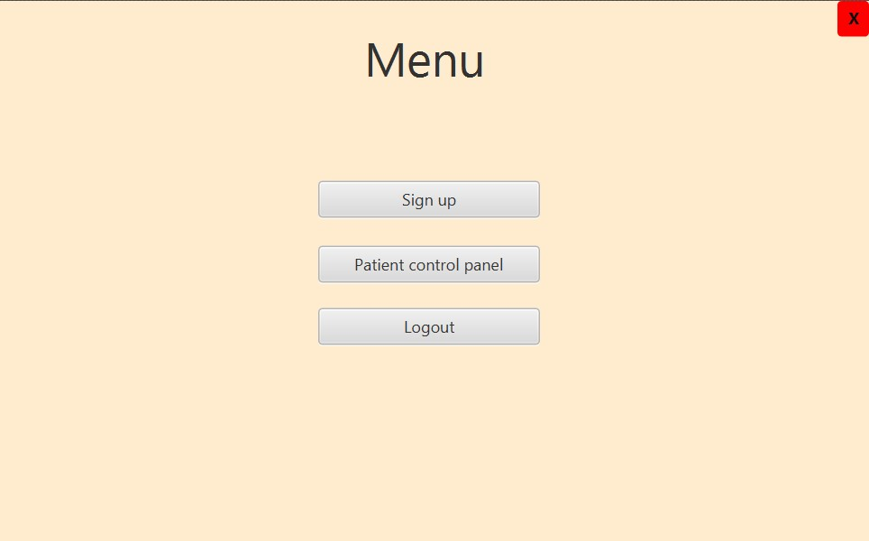

Slide 13

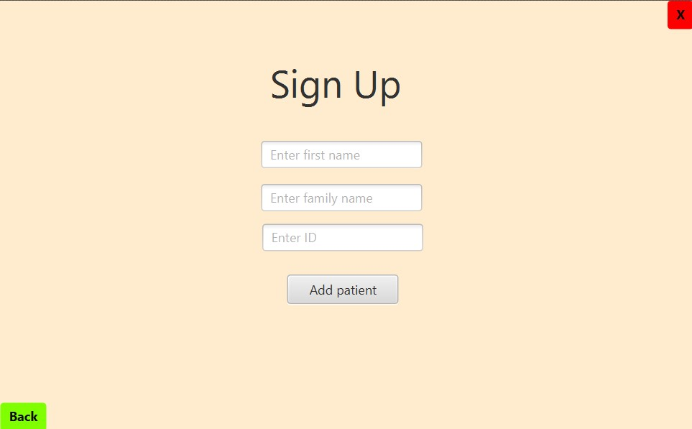

Slide 14

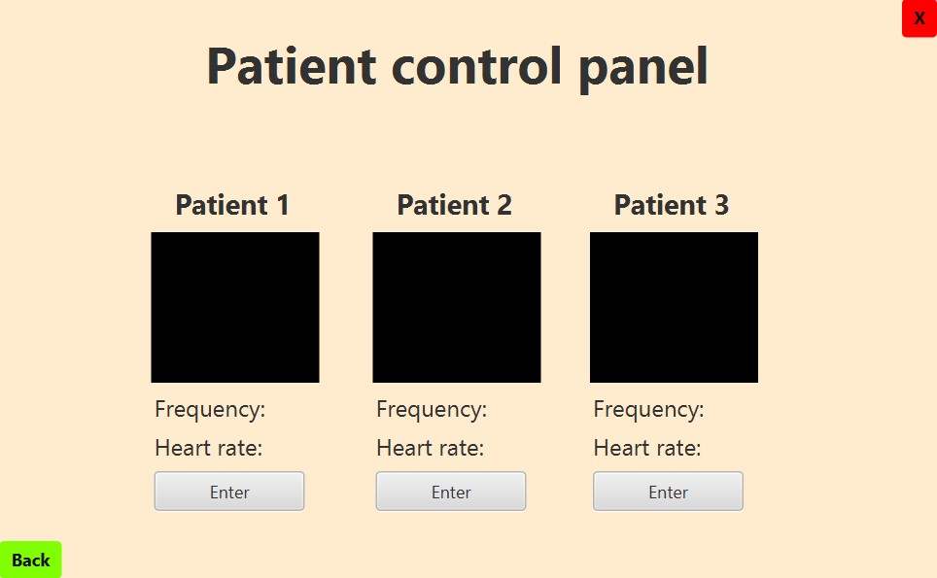

Slide 15
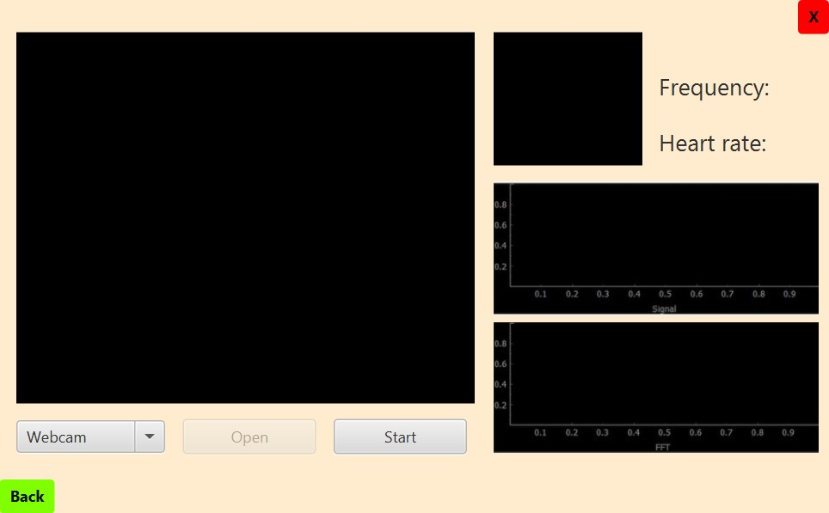
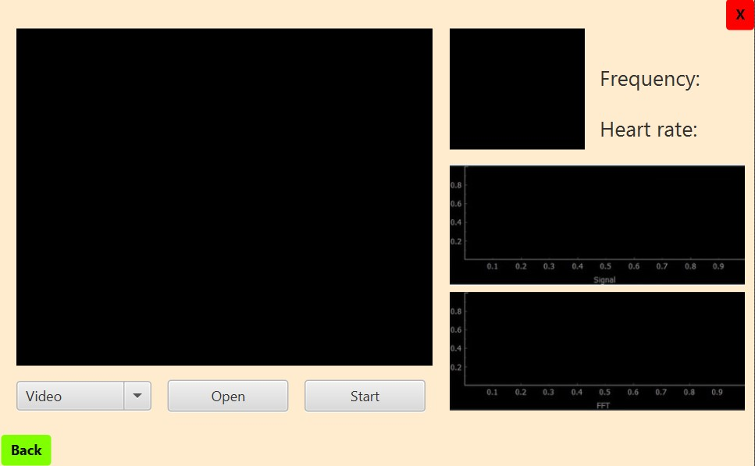
Heartrate Monitoring Screen

Slide 16
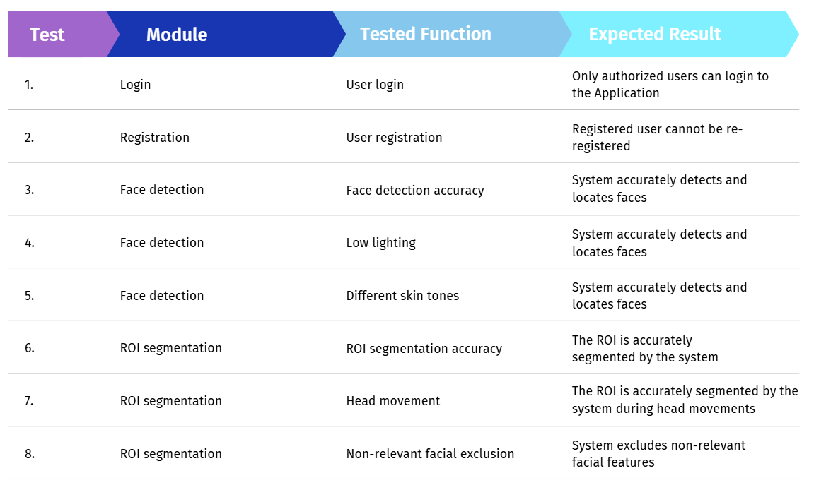
Verification

Slide 17
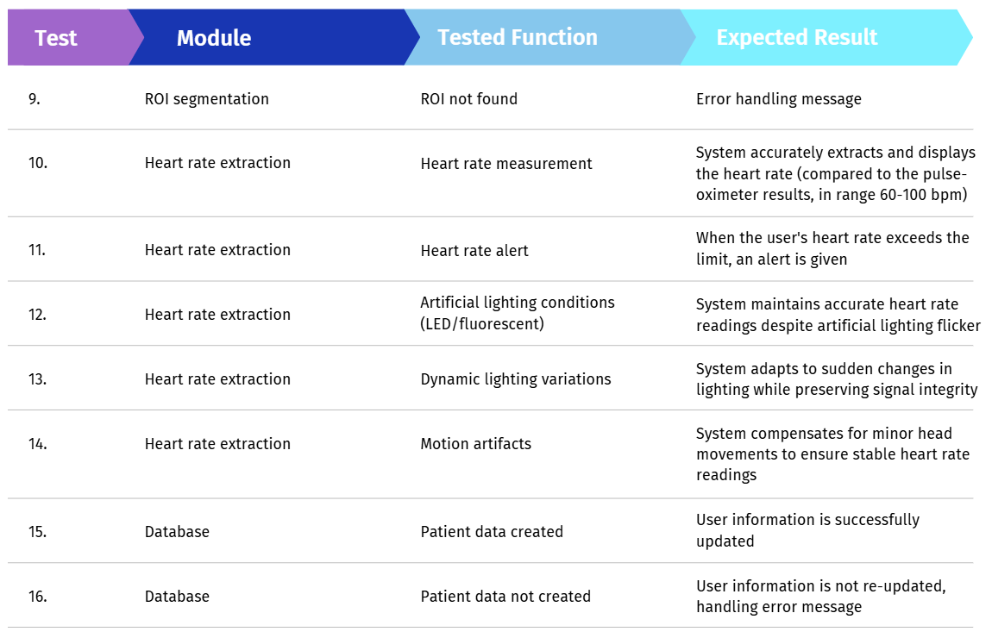
Verification

Slide 18

Medical Challenges
Understanding Heart Physiology –familiarize ourselves with cardiovascular anatomy and physiology to accurately interpret heart rate and circulation.
Mastering Photoplethysmography – Grasping how blood flow and hemoglobin impact heart rate measurements is a key to ensuring accuracy.
Medical Research Challenges – Without a clinical background, navigating medical terminology and assessing reliable sources proved to be a challenge.

Slide 19

Implementation Challenges
Image Processing Knowledge Gap –bridge our understanding of image processing to apply the right techniques for accurate heart rate extraction from video.
Optimizing Signal Quality – Finding the best image processing methods is crucial to enhancing signal clarity while keeping noise and artifacts to a minimum.
Balancing Speed and Accuracy – Ensuring real-time heart rate measurement required optimizing performance without compromising accuracy or overloading computational resources.

Slide 20

Thank You For Listening!

